Slide 1

Our World
Population-Agriculture- Emmission

Slide 2
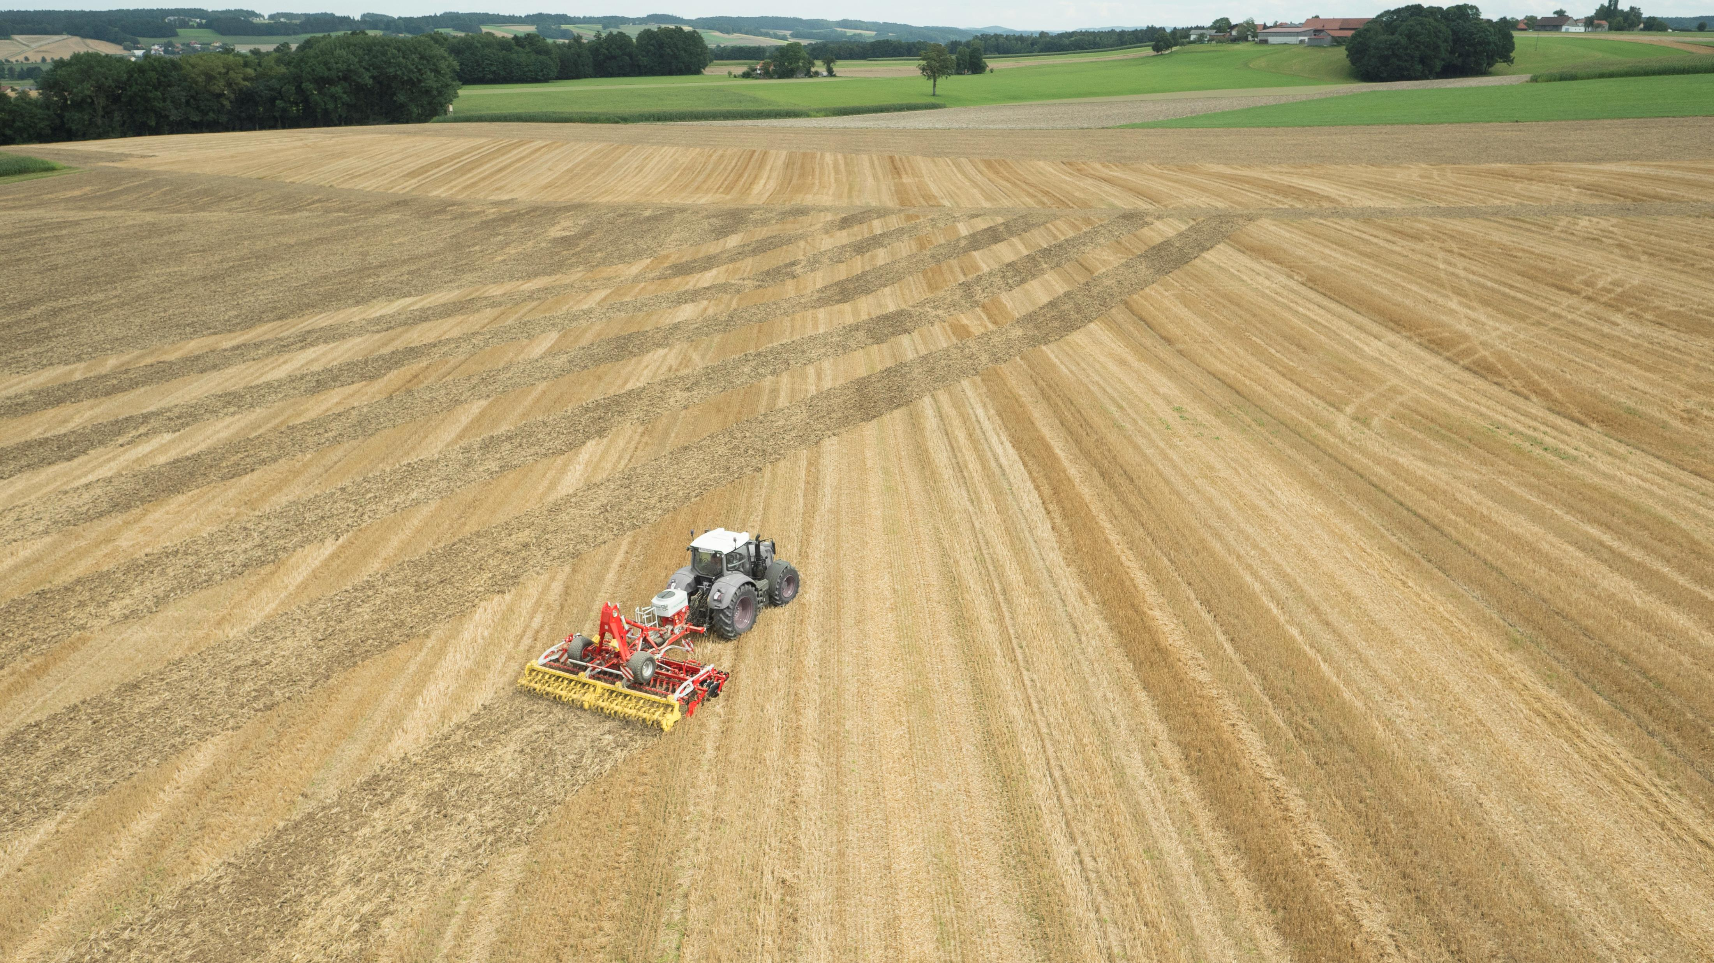
Agriculture:
One of the most important yet overlooked factor causing global emissions is agriculture, we tried to see how agricultural output affects emissions across different countries.

Slide 3
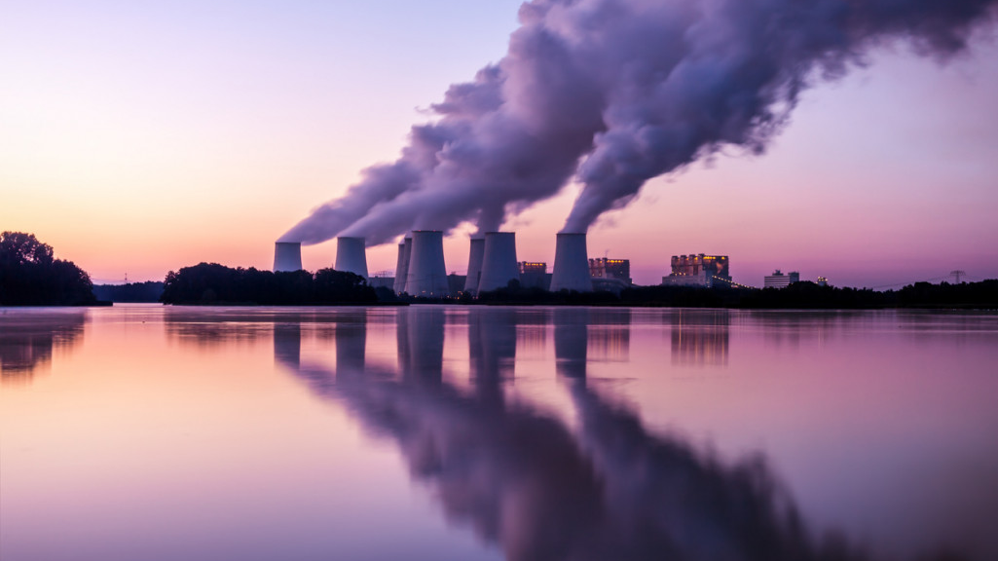
Emissions:
Greenhouses gases are the biggest and sole reason of global warming affecting each one of us directly and indirectly we looked at this fact from perspective of gases emitted by each country since 2000 to 2017. Analysis data of gases such as carbon dioxide, methane and nitrous oxide.

Slide 4

Population:
With population growth we can see increase in demand of food and resources, putting extra strain on available natural resources to satisfy basic needs. We looked at population data across countries from 200 to 2017 and see its incremental growth.

Slide 5

Visualization:
To showcase huge data following technologies were used .
Python
Flask
Postgres
Pandas
HTML/CSS
Leaflet (D3), Plotly.

Slide 6
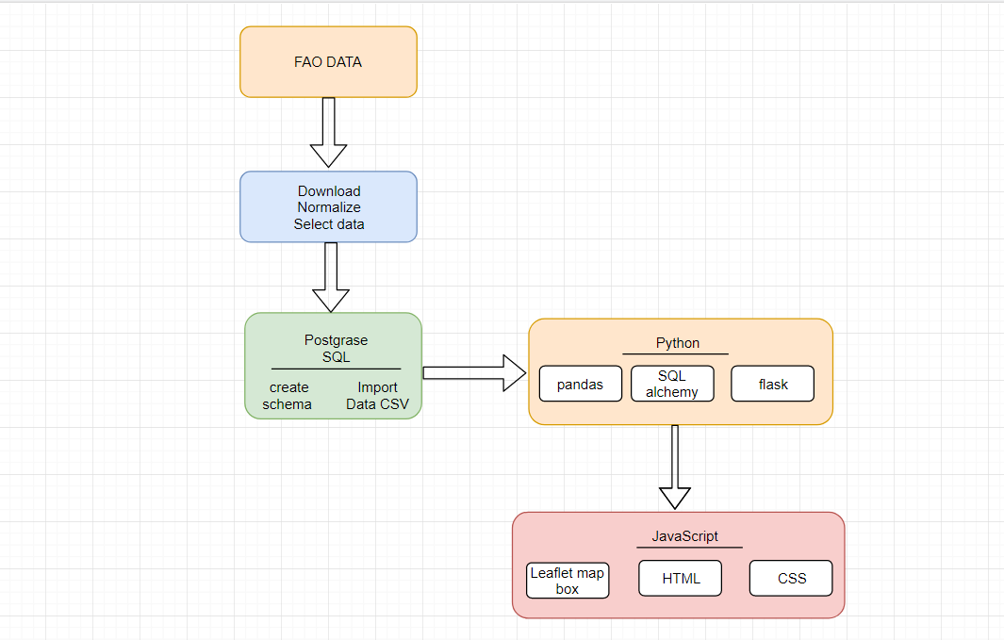
Project Workflow:
From data extraction, transformation and loading was done as per adjacent workflow and technologies mentioned.

Slide 7

Our Data:
http://www.fao.org/faostat/en/#data/GT

Slide 8
Agriculture V/s Years

Slide 9
Emissions V/s Years

Slide 10
Population V/s Years

